Slide 1
HEALTHY LIFESTYLE

Slide 2

Czech Judo Federation founded 1993
Number of members (2025) 25 600
Number of clubs (2025) 212

Slide 3

TJ SOKOL PRAHA VRŠOVICE founded 1938
Number of memebers: 380
Number of coaches: 12

Slide 4
Since 1992, our club has had a YOUTH SPORTS BASE under the Czech Sokol Organization ( 25 competitors)
We take part in most national competitions from U8 to veterans
We compete in: - Mens Extraliga (2x champions)
- Junior and youth leagues
- Womens Team – 16x winner of the national championship
Best competitor: Jaromír Ježek ( 3x Olympic Games participant)

Slide 5
INTRODUCING
JAROSLAV BANSZEL
1st class coach, club president (25 years) + coach (45 years) Veterans' representative coach (9 years)
DAGMAR BANSZELOVÁ
Certified, professional trainer (35 years) + accountant
czech junior, senior and veteran reprezentant

Slide 6
GRUPS
1/ Course 3 - 5 years
2/ Course 5 - 6 years
3/ Course 6 - 10 years
4/ Prep school U8 and U10
5/ Young U10
6/ Pupils A,B,C U12 – U14
7/ Cadets U16 – U18 /best group/
8/ Juniors + men

Slide 7
Forming basic habits
Age 5 – 7 years – ideally already starting at this age
Age 8 – 12 years – developing a positive relationship with a healthy
lifestyle
Age 13 – 18 years – the athlete has already greater responsibility

Slide 8
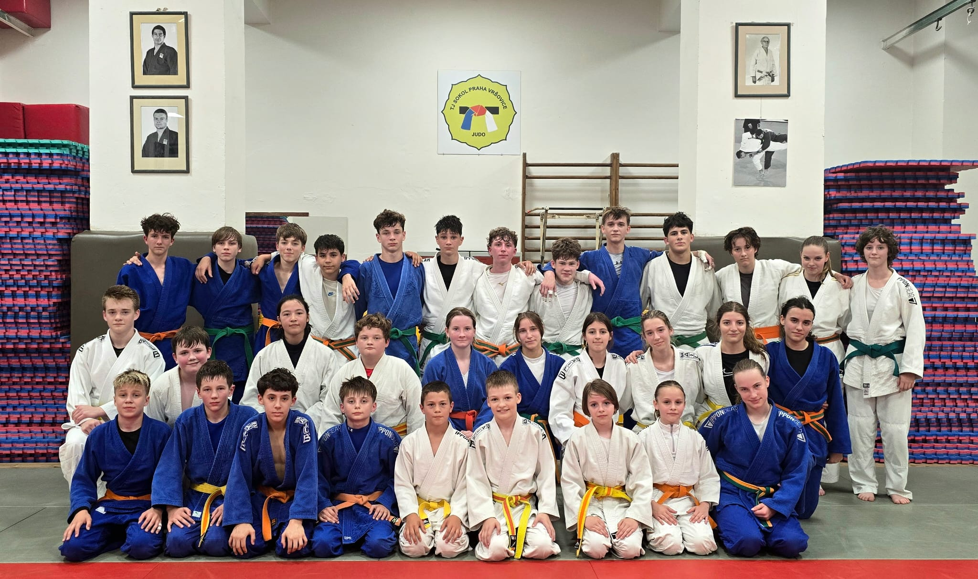
Target group for our research

Slide 9
approximately 15
This year this group has already had approximattely 15 competions. Therefore a healthy lifestyle is necessary for success!!!
Underestimating a healthy lifestyle can lead to reduced performance!!!
Practice: It happens that a competitor feels sick on the tatami – he vomits. ( poor diet, lack of sleep, nervousness…)

Slide 10
REALITY
1/ DIET
Many athletes lack knowledge about nutrition (They rely on what they get at home or what they buy themselves)
Preference for fast food, sweets, and energy drinks
Unsafe or harmful weight cutting practices: fasting, extreme dehydration…

Slide 11
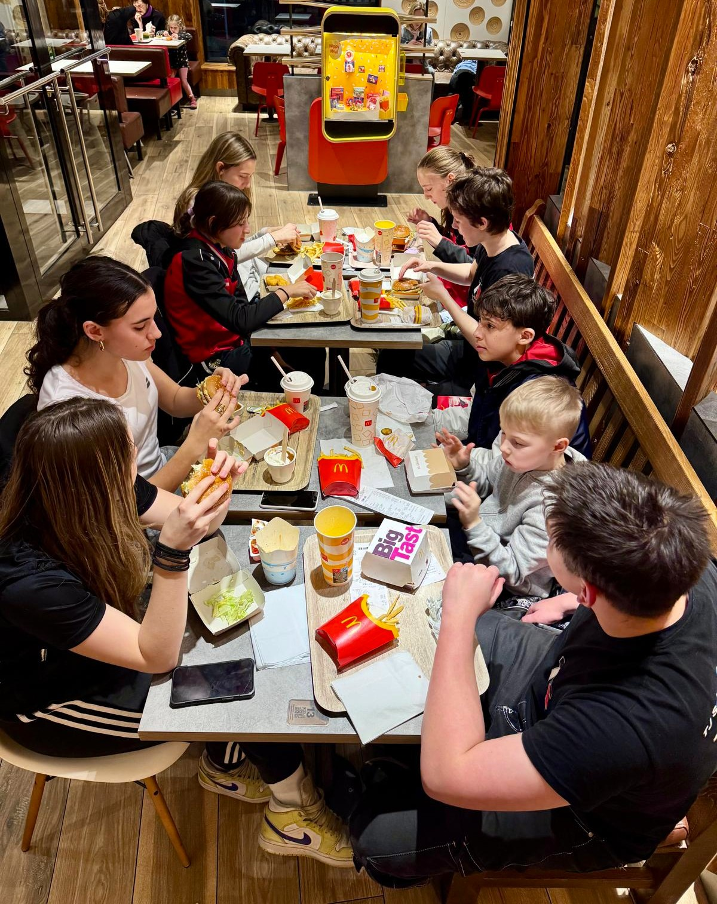

Slide 12
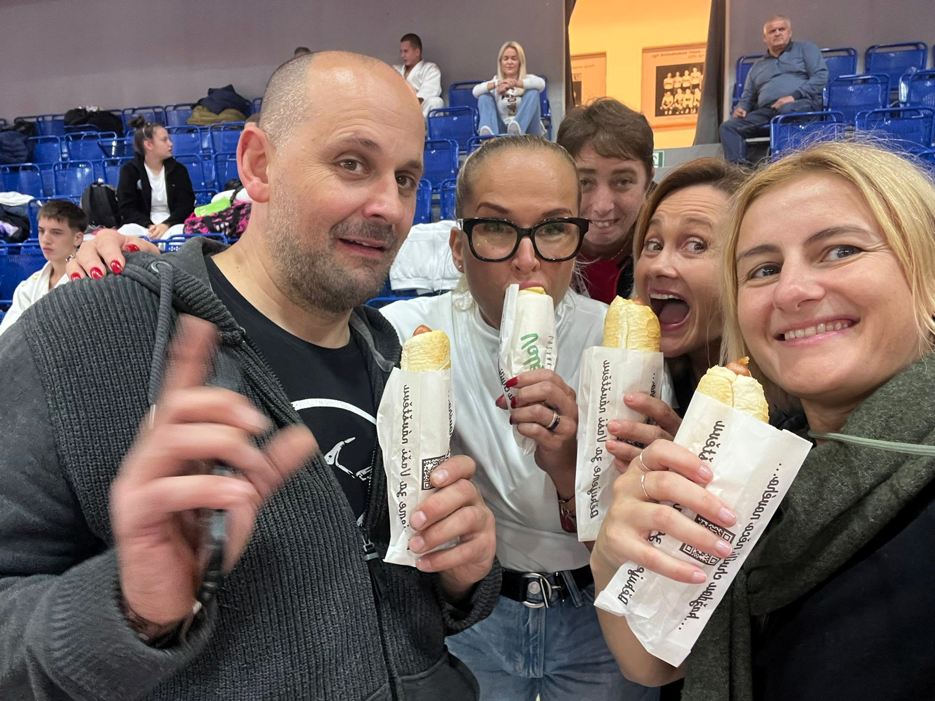
Unfortunately, sometimes parents lead by example

Slide 13
🛌 Sleep & Recovery
Common Challenges:
Insufficient - little sleep
– Often caused by excessive screen time (phones, gaming, social media)
Lack of regular recovery routines
– No time for active rest, stretching, or mental regeneration

Slide 14
💧 Hydration Habits
What We Often See:
Low daily fluid intake
Poor beverage choices:
– Sugary sodas, energy drinks, and other stimulants

Slide 15
Supporting a Healthy Lifestyle in Our Judo Program
Long-term athlete development:
We raise our judokas from the very beginning,
focusing on general physical and mental development.
Early foundation with gymnastics:
A gymnastics coach supports our youngest children along side
judo coaches to build coordination and movement skills.
Multisport camps:
We organize:
Day camps and summer training camps in collaboration with gymnastics coaches
Winter training camps including skiing instruction
Notes:
Slide Title: Supporting a Healthy Lifestyle in Our Judo Program
🎙️ Speaker Notes / Script:
"One of the key pillars of our program is promoting a healthy lifestyle as part of long-term athlete development.
From the youngest age groups, we focus not only on judo technique, but also on general physical and mental development. Our youngest judokas train under the guidance of both judo and gymnastics coaches. This early exposure to gymnastics helps improve coordination, balance, and movement control — essential foundations for future progress in judo.
To keep things engaging and well-rounded, we organize day camps and summer training camps in cooperation with gymnastics clubs. During winter, our athletes take part in ski camps that offer both physical challenge and fun — while continuing to build endurance and agility.
Education is another key element. Throughout the season, we hold lectures and workshops focused on health, nutrition, injury prevention, and overall athlete wellness.
At every competition, we take time to remind athletes and parents about the importance of proper nutrition — not just on the day of the event, but before and after as well. We believe that building these habits early is crucial for long-term performance and well-being.
We also ensure that our athletes undergo regular medical check-ups, and we carefully monitor and evaluate the results.
In terms of injury prevention and recovery, we closely cooperate with a physiotherapist. Stretching routines, functional training, and core stability exercises are integrated into our weekly training plan.
Finally, we’re very lucky to work with a club doctor — an orthopedic specialist and former judoka from our own team. Thanks to his background in judo, he can assess injuries in a way that truly understands the sport’s physical demands.
This holistic approach allows us not only to develop competitive athletes, but also to support their long-term health and well-being."

Slide 16
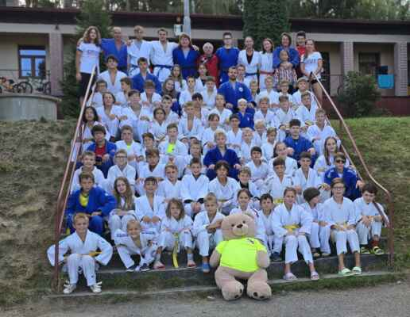

Slide 17
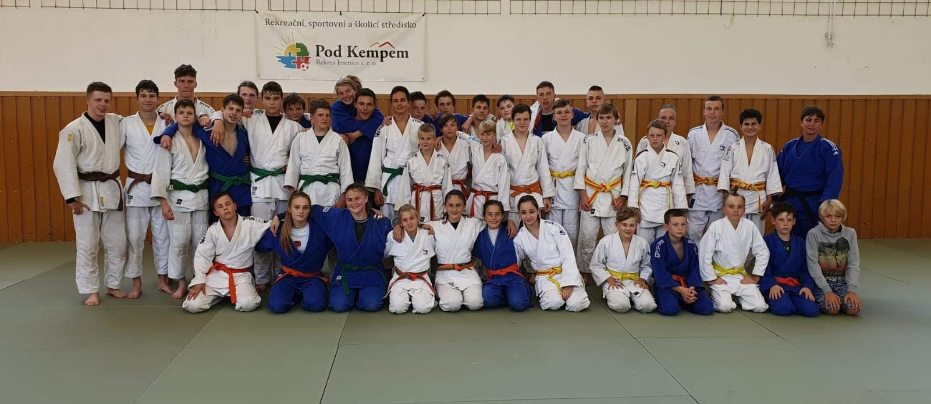

Slide 18
Educational activities:
Regular lectures and workshops on health, training, and lifestyle topics
Nutrition awareness:
At each competition, we highlight basic nutritional rules —
what to eat before, during, and after matches.
Medical monitoring:
Routine medical check-ups for all athletes
Health data is reviewed and tracked over time

Slide 19
Physiotherapy support:
Cooperation with a physiotherapist
Regular sessions focused on stretching, injury prevention,
and core muscle strengthening
Individualized treatment when needed
Club doctor – orthopedist:
A former judoka and club member
Assesses injuries with an understanding of judo-specific demands

Slide 20
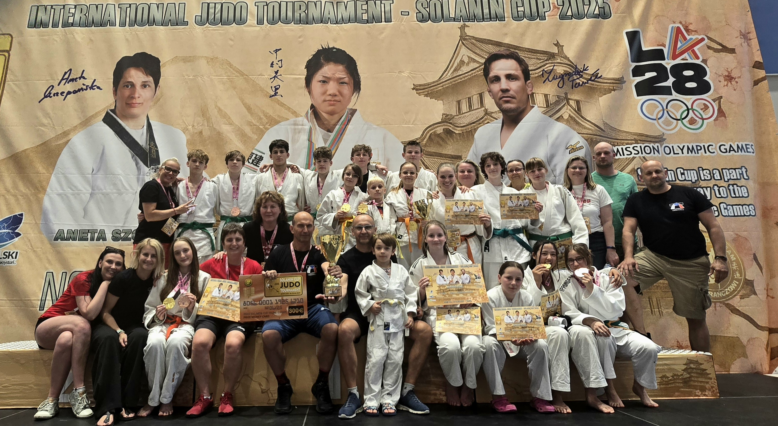
THEN WE WIN

